Slide 1
Autonomous Multi-cycle Farming in Space
Christopher Millsap , Giampiero Corsbie
Client/ Sponsor: Dr. Philip Chan

Slide 2
Milestone 3
Task | Giampiero | Christopher
Decide which set of boards will be used to control the system other than the microcontroller | Responsible - 50% | Responsible - 50%
Implement Python libraries for serial communication | Responsible - 50% | Responsible - 50%
Finalize development toolchain and environment | Responsible - 50% | Responsible - 50%
Start a preliminary product breakdown structure with MEE | Responsible - 50% | Responsible - 50%
At least one sensor & actuator functioning according to some schedule These will run based on simulated data along with simulated cycles | Responsible - 50% | Responsible - 50%
Last slide:

Slide 3
Milestone 3
Task | Giampiero | Christopher
Full simulated farm with well-defined input parameters | Responsible - 50% | Responsible - 50%
Configuration file for all phases in system to run in simulation | Responsible - 50% | Responsible - 50%
Testing Document inheriting from test plan from milestone 1 | Responsible - 50% | Responsible - 50%

Slide 4
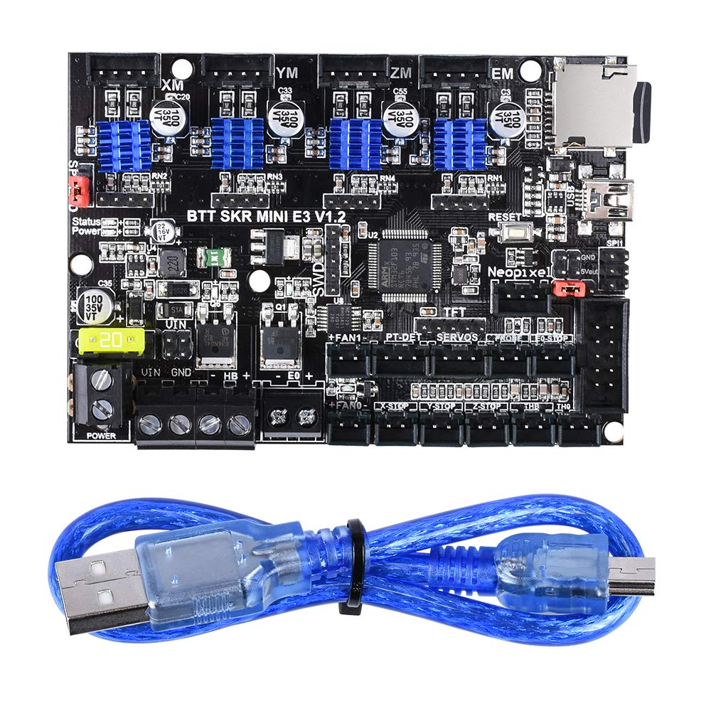
Decide which set of boards will be used to control the system other than the microcontroller
BIGTREETECH SKR Mini E3 V1.2 Control Board 32Bit with TMC2209 UART Driver
Commonly used with 3D printers
Has multiple drivers integrated into the board
Designed for running stepper motors precisely and accurately
Can run G-Code
Will be used for controlling seeding head movement on the linear rails

Slide 5
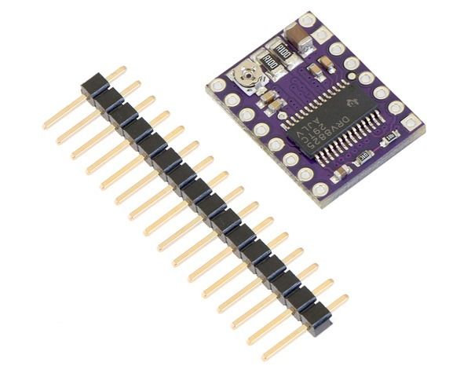
Decide which set of boards will be used to control the system other than the microcontroller
DRV8825 Stepper Motor Driver Carrier, High Current

Slide 6
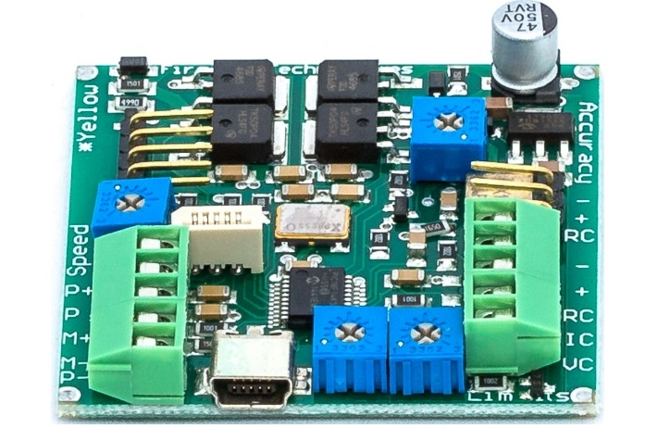
Decide which set of boards will be used to control the system other than the microcontroller
Linear Actuator Control Board by Actuonix
Will be used to control the linear actuator that deposits seeds in the grow trays

Slide 7
Implement Python libraries for serial communication
Adafruit_BBIO.GPIO
Used on:
The lux sensor
ULN2003 5V Stepper Motors
ULN2003 Driver Boards
Used in the demo and have libraries specific to their use implemented as examples.

Slide 8
Finalize development toolchain
Given the portability and ease of development in python, no formal toolchain is necessary.
Instead, one simply needs to know how to set up the development environment.
Python dependencies for the BeagleBone
sudo ntpdate pool.ntp.org
sudo apt-get update
sudo apt-get install build-essential python-dev python-setuptools python-pip python-smbus -y
Virtual Environment
python3 -m pip install --user virtualenv
python3 -m venv env
source env/bin/activate
Libraries
pip install Adafruit_BBIO
pip3 install coloredlogs
pip3 install ruamel.yaml
VS Code and Remote Development Extension (If developing on windows)

Slide 9
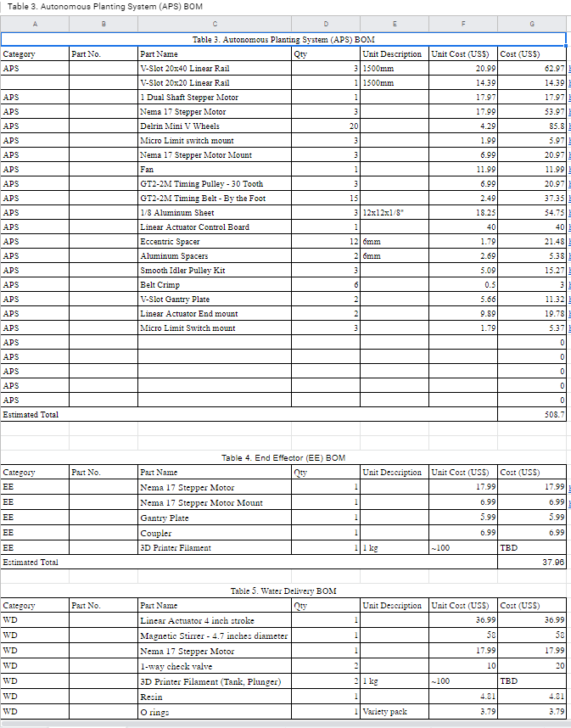
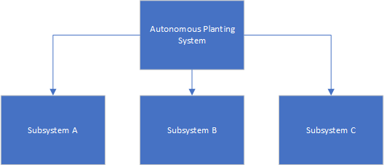
Start a preliminary product breakdown structure with MEE
BOM File
Broken down by subsystem/assembly
PBS derived when BOM finalized

Slide 10
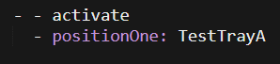
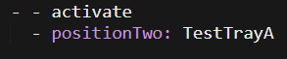
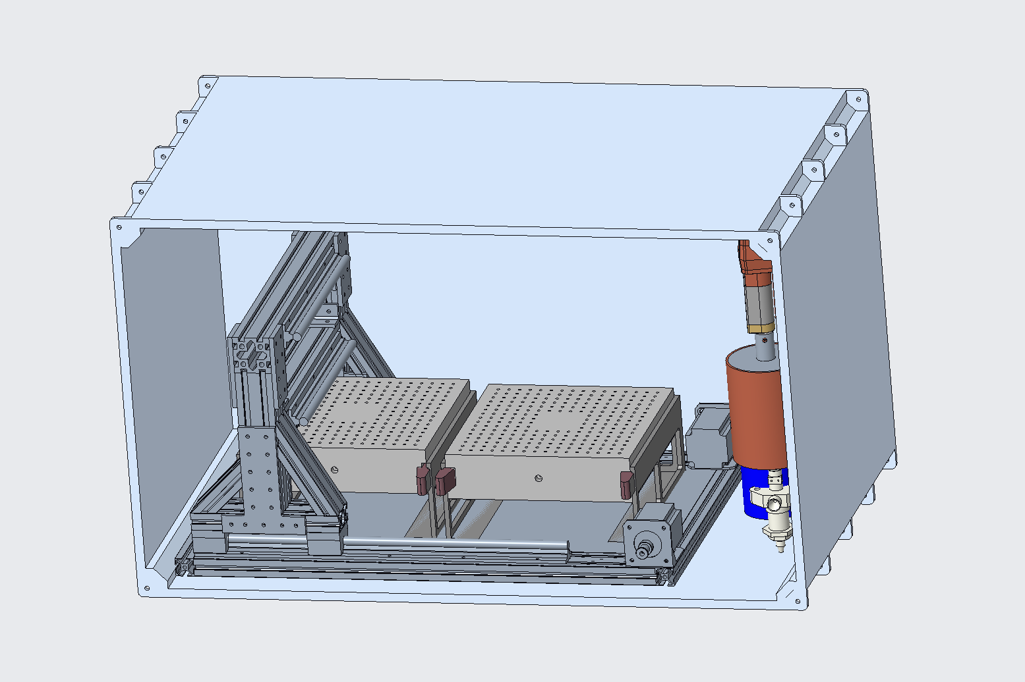
Features added
Adjustable trays
In config and as classes
Procedures in config file i.e. “seeding” actuator procedure
Detecting if classes exist for hardware requested in config file
Threadable Actuator base class for running actuators in parallel to the system
Parallel sensor reads

Slide 11

Testing

Slide 12
Testing
Static - Done by reading code through formal reviews
Functional - Verifies that each function of the software application operates in conformance with the requirement specification
Structural - Whitebox testing, testing trigger conditions, interface, etc, non functional
Performance - Responsiveness and stability under a particular workload
Testing scripts - Automated testing
Reliability
Security
Maintainability
Coverage
Duplications
Size
Complexity
Issues
Notes:
Reliability: unexpected behavior
Security: Hackers can exploit
Maintainability: More difficult to update competently
Coverage: a measure used to describe the degree to which the source code of a program is executed when a particular test suite runs
Duplications: a sequence of source code that occurs more than once, either within a program or across different programs owned or maintained by the same entity
Size: How big?
Complexity: Cyclomatic and Cognitive
Issues: Entire list of problems...

Slide 13
Testing
 | Simulated Farm | Sensor | Actuator
Single Stage | State cases | Expected data behavior for features | Expected actions and reactions for features
One Cycle | State and transitions cases | Expected data behavior for features | Expected actions and reactions for features
Multi Cycle | Multiple sets of state and transition cases | Expected data behavior for features | Expected actions and reactions for features
Full debug suite in development

Slide 14
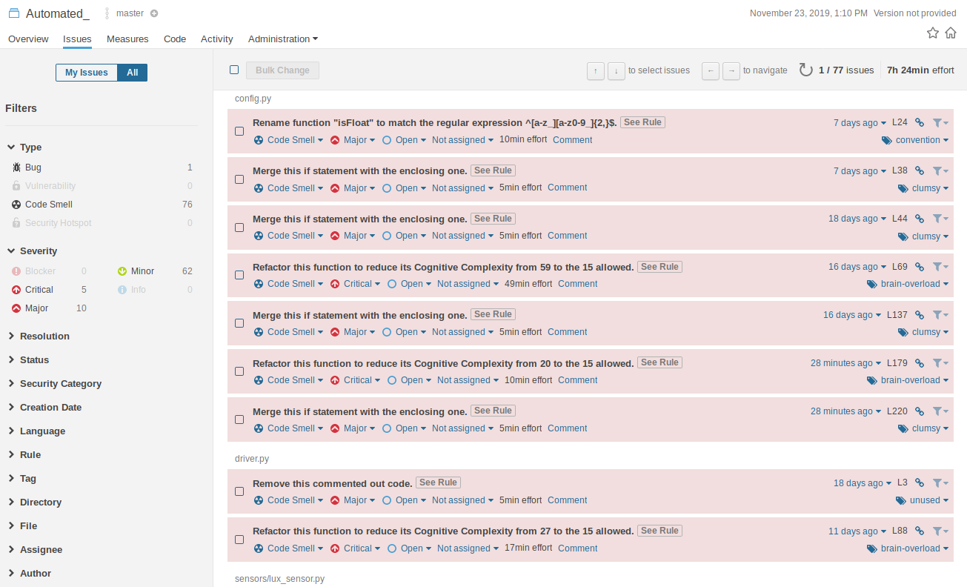

Slide 15
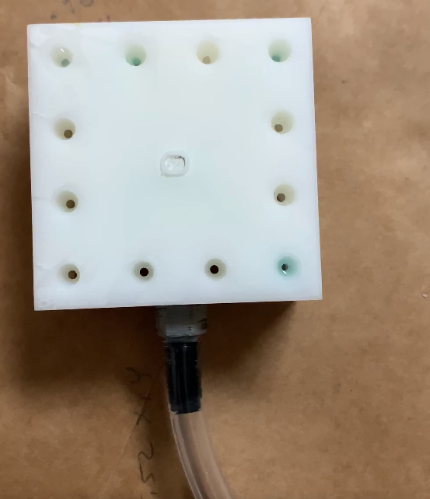
New Testing Tasks (over break)
Full cycle analog
2 - 3 week run
Real water pump to control water to seeds/plants
Not testing pump only testing system running over time
Testing for timing issues expected to actual
Debugging Suite for dynamic analysis

Slide 16
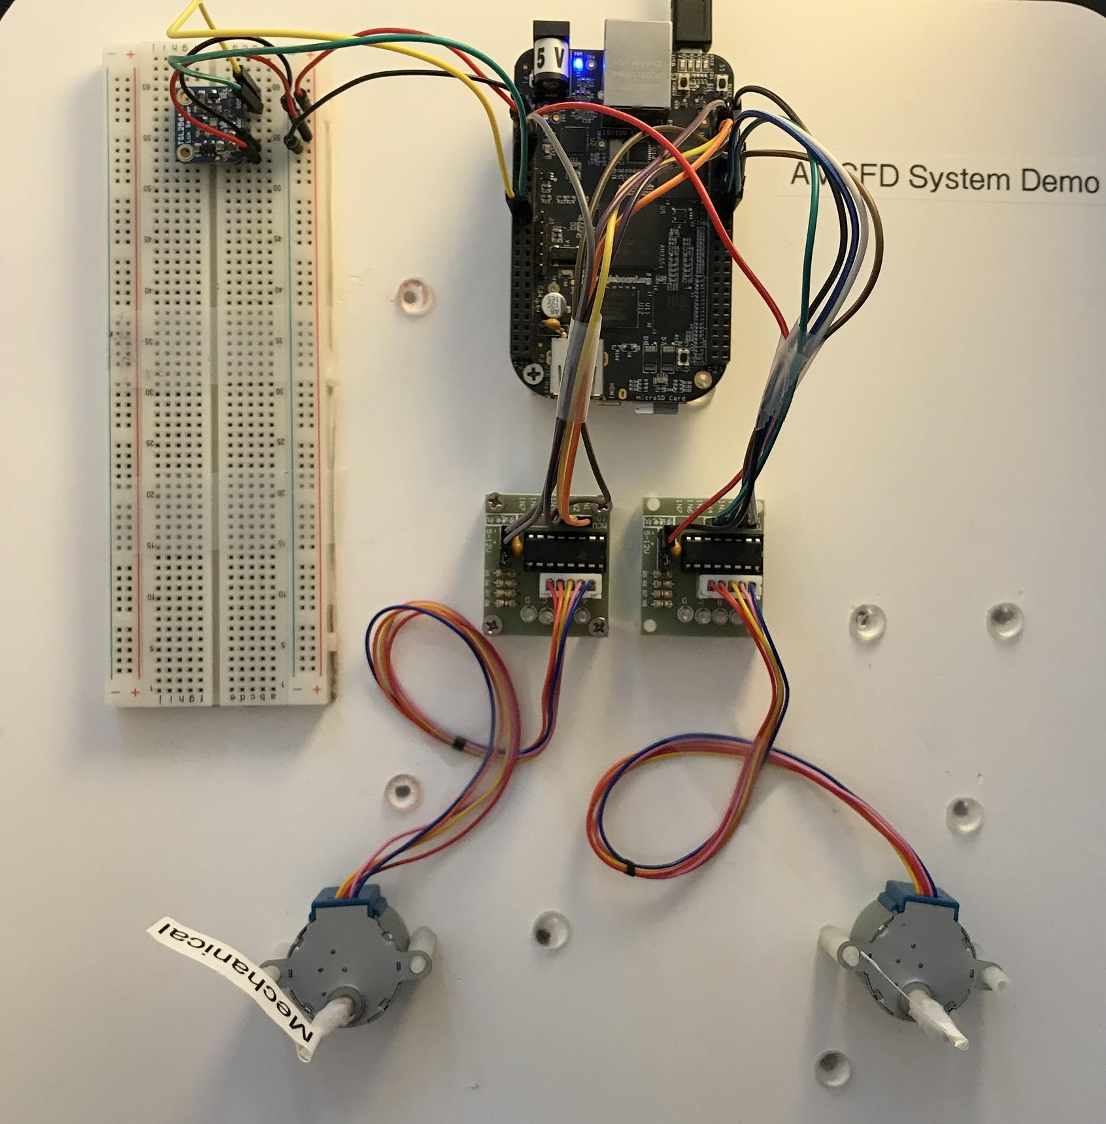
At least one sensor & actuator functioning according to some schedule - Demo
Canopy Light
Tasks included:
Full simulated farm with well-defined input parameters
Configuration file for all phases in system to run in simulation
Demo System:
Virtual sensors from simulator:
Height
Moisture
Hardware Sensor
Lux
Actuators - run by two drivers
Mechanical arm (left)
Water pump (right)

Slide 17
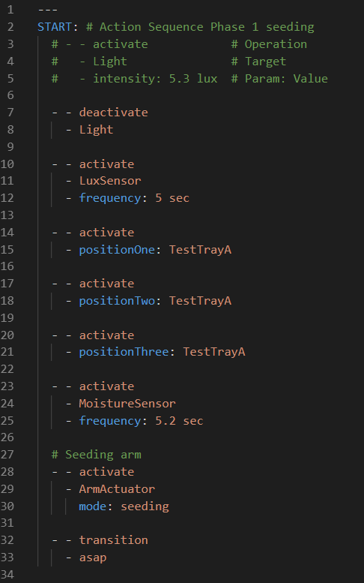
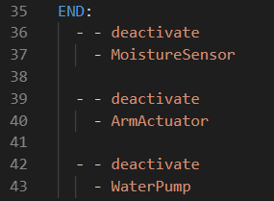
Demo - Phase 1: Seeding

Slide 18
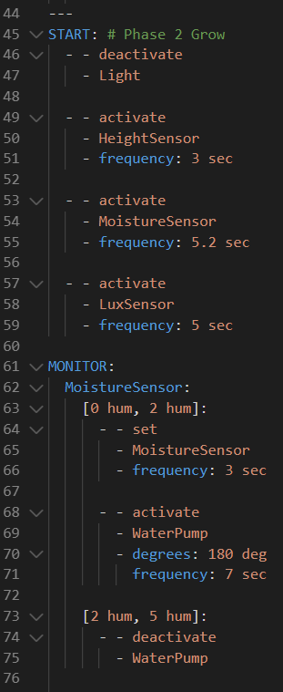
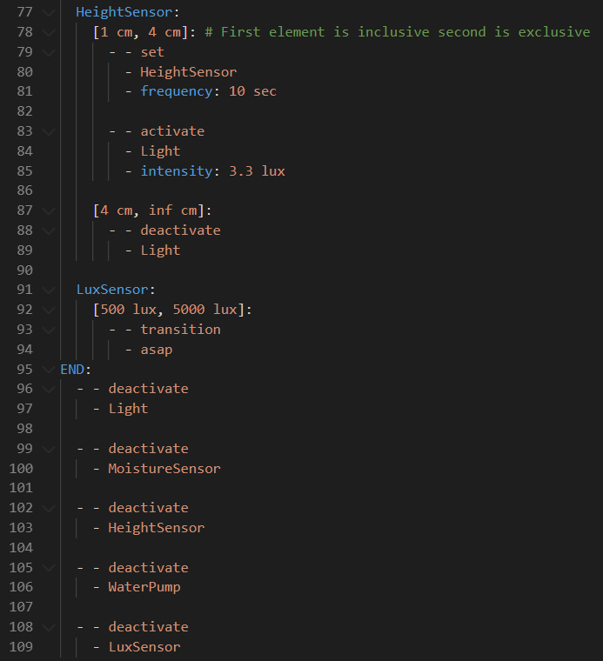
Demo - Phase 2: Grow

Slide 19
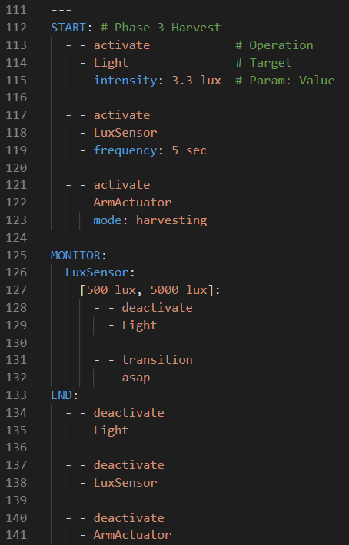
Demo - Phase 3: Harvest

Slide 20
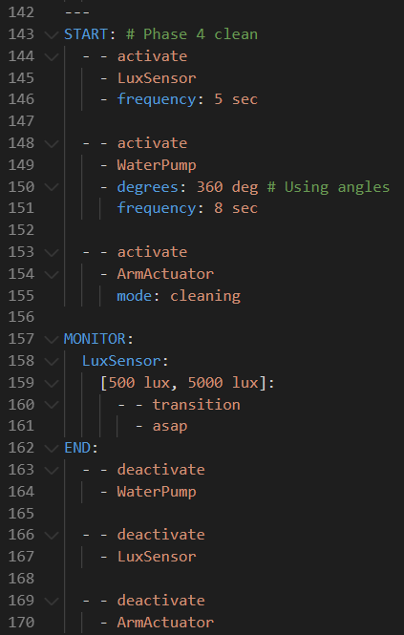
Demo - Phase 4: Clean

Slide 21
Plans for Next Milestone
Task | Giampiero | Christopher
System Interrupts and Error Handling | 50% | 50%
Allow for Manual Control | 50% | 50%
System Debug Suite | 50% | 50%
Config Section for System Settings | 50% | 50%

Slide 22

Questions?

Slide 23
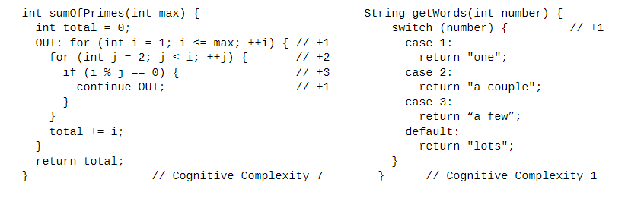
Cognitive Complexity
Figure 3: [2]
Notes:
A Cognitive Complexity score is assessed according to three basic rules:
1.Ignore structures that allow multiple statements to be readably shorthanded into one
2.Increment (add one) for each break in the linear flow of the code
3.Increment when flow-breaking structures are nested
Additionally, a complexity score is made up of four different types of increments:
A.Nesting - assessed for nesting control flow structures inside each other
B.Structural - assessed on control flow structures that are subject to a nesting
increment, and that increase the nesting count
C.Fundamental - assessed on statements not subject to a nesting increment
D.Hybrid - assessed on control flow structures that are not subject to a nesting
increment, but which do increase the nesting count

Slide 24
Cognitive Complexity
A Cognitive Complexity score is assessed according to three basic rules:
Ignore structures that allow multiple statements to be readably shorthanded into one
Increment (add one) for each break in the linear flow of the code
Increment when flow-breaking structures are nested
Additionally, a complexity score is made up of four different types of increments:
Nesting
Structural
Fundamental
Hybrid
Notes:
A Cognitive Complexity score is assessed according to three basic rules:
1.Ignore structures that allow multiple statements to be readably shorthanded into one
2.Increment (add one) for each break in the linear flow of the code
3.Increment when flow-breaking structures are nested
Additionally, a complexity score is made up of four different types of increments:
A.Nesting - assessed for nesting control flow structures inside each other
B.Structural - assessed on control flow structures that are subject to a nesting
increment, and that increase the nesting count
C.Fundamental - assessed on statements not subject to a nesting increment
D.Hybrid - assessed on control flow structures that are not subject to a nesting
increment, but which do increase the nesting count

Slide 25
Cognitive Complexity
A Cognitive Complexity score is assessed according to three basic rules:
Ignore structures that allow multiple statements to be readably shorthanded into one
Increment (add one) for each break in the linear flow of the code
Increment when flow-breaking structures are nested
Additionally, a complexity score is made up of four different types of increments:
Nesting - assessed for nesting control flow structures inside each other
Structural - assessed on control flow structures that are subject to a nesting increment, and that increase the nesting count
Fundamental - assessed on statements not subject to a nesting increment
Hybrid - assessed on control flow structures that are not subject to a nesting increment, but which do increase the nesting count

